Slide 1
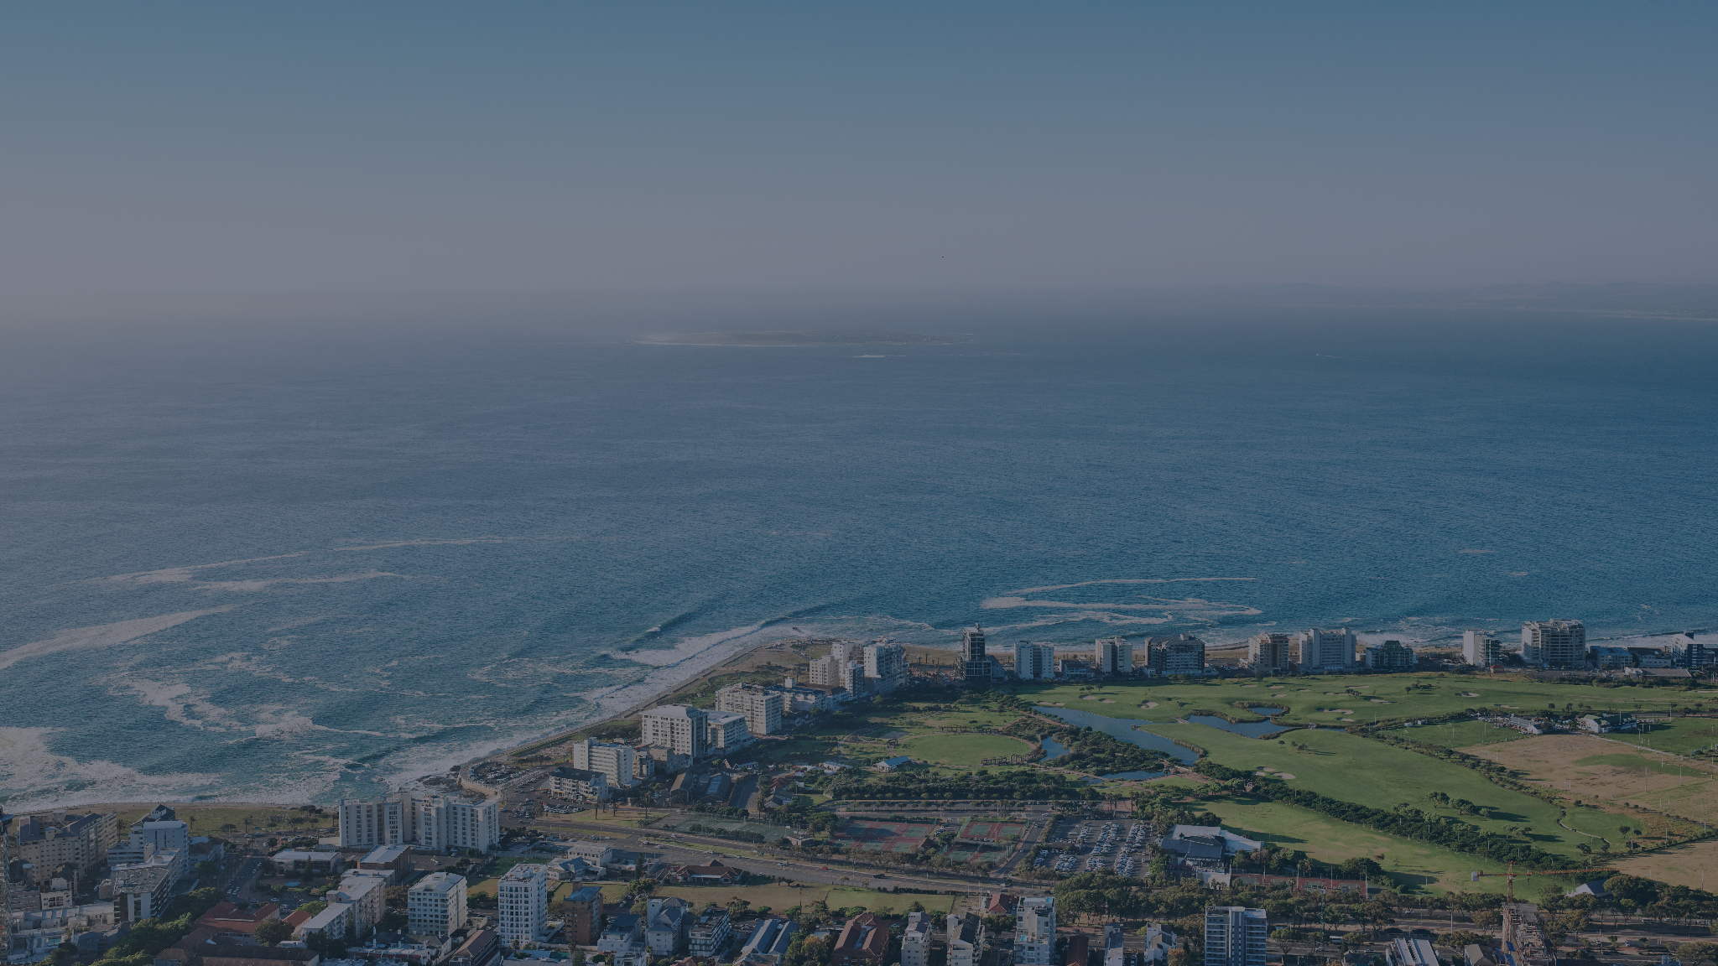

DOOH BEST PRACTICE
Get the best out of your DOOH campaigns.

Slide 2



REACHING AUDIENCES ACROSS SCREENS THAT MATTER
Vicinity Media connects brands with consumers via its DOOH network (900+ sites), top publishers and mobile screens in high-traffic, high-impact environments.
As Africa’s leading Adtech and Data business, we deliver targeted, location-based advertising using advanced 1st party location data to drive real-world results.
We don’t just serve ads to relevant audiences based on location — we empower brands to maximise the impact of their omnichannel campaigns.
From seamlessly delivering campaigns to the right audiences at the right time and place, to providing added value through best-practice guidance and measuring real user engagement, we help brands achieve better results at every stage of the user journey.

Slide 3

DOOH BEST PRACTICE OVERVIEW
Your target audience typically has just 3–7 seconds of viewing time when driving past a roadside billboard.
These best-practice guidelines are designed to help your creative team make every second count and optimise assets for maximum DOOH impact and performance:
Keep It Simple
Make Branding Unmissable
Design for Roadside Impact
1
2
3
Content is King, Context is King Kong
Motion with Purpose
Clear Call To Actions (CTAs)
4
5
6
Refresh Regularly & Rotate Often
Keep Omnichannel Integration Top of Mind
Dynamic DOOH Creative
7
8
9

Slide 4
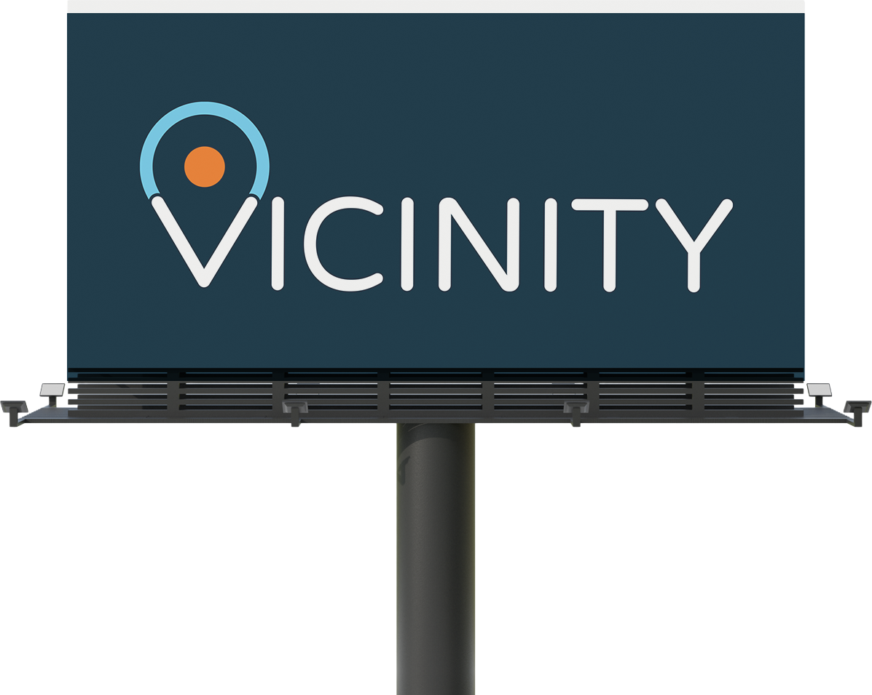

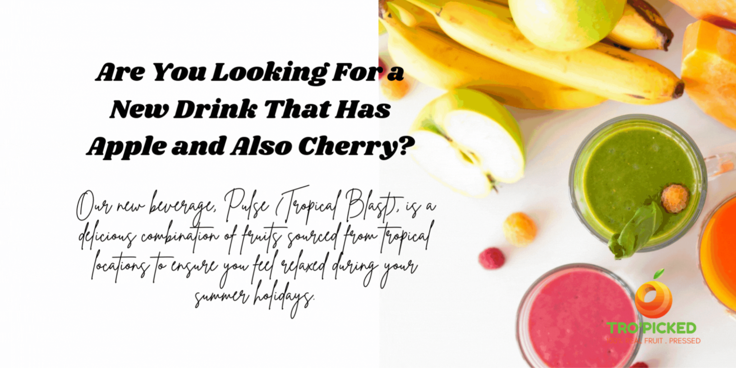
KEEP IT SIMPLE, FAST & LEGIBLE
DON’T
DO
Use dense blocks of text.
Rely on thin or decorative fonts.
Overcomplicate with too many messages.
Use bold colours, high contrast (avoid white backgrounds).
Clear product shots or single focal point visuals.
Short, punchy copy (≤ 7 words)
Large, bold, sans-serif fonts.

Slide 5

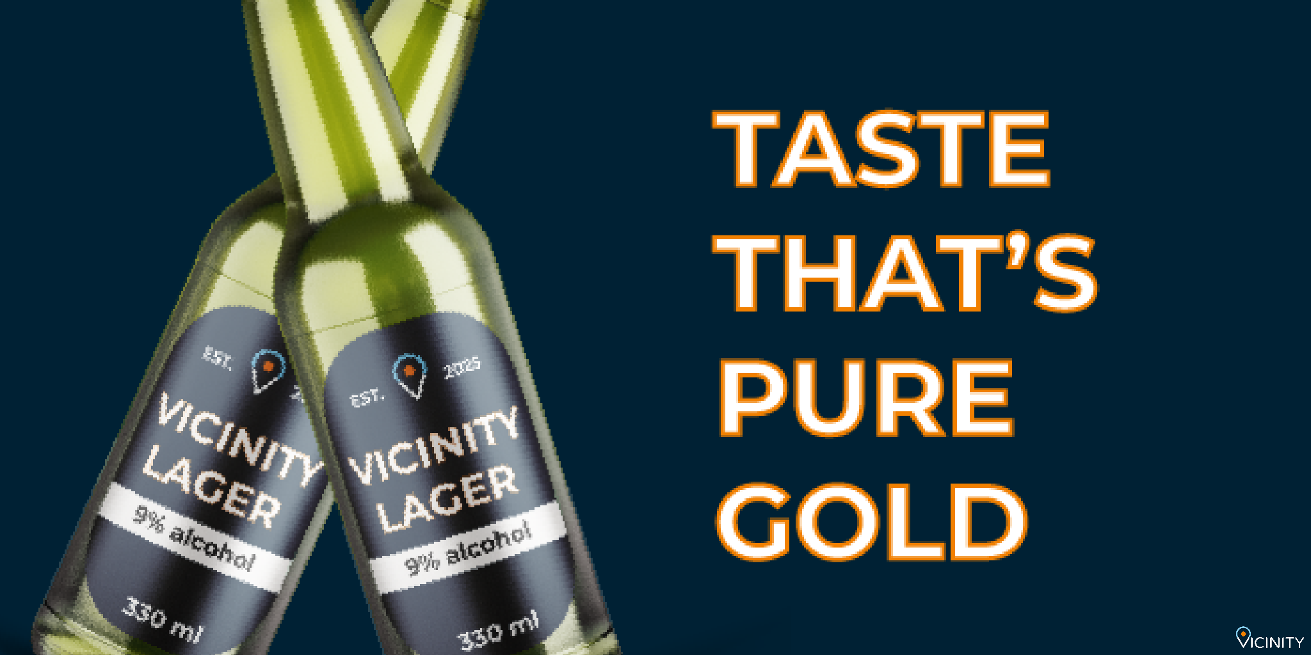
MAKE BRANDING UNMISSABLE
DON’T
DO
Hide or shrink the logo.
Use low-quality visuals.
Let product overshadow the brand.
Place the logo prominently.
Highlight hero products with bold visuals.
Tip:
Consistent branding builds trust and recall over time.

Slide 6
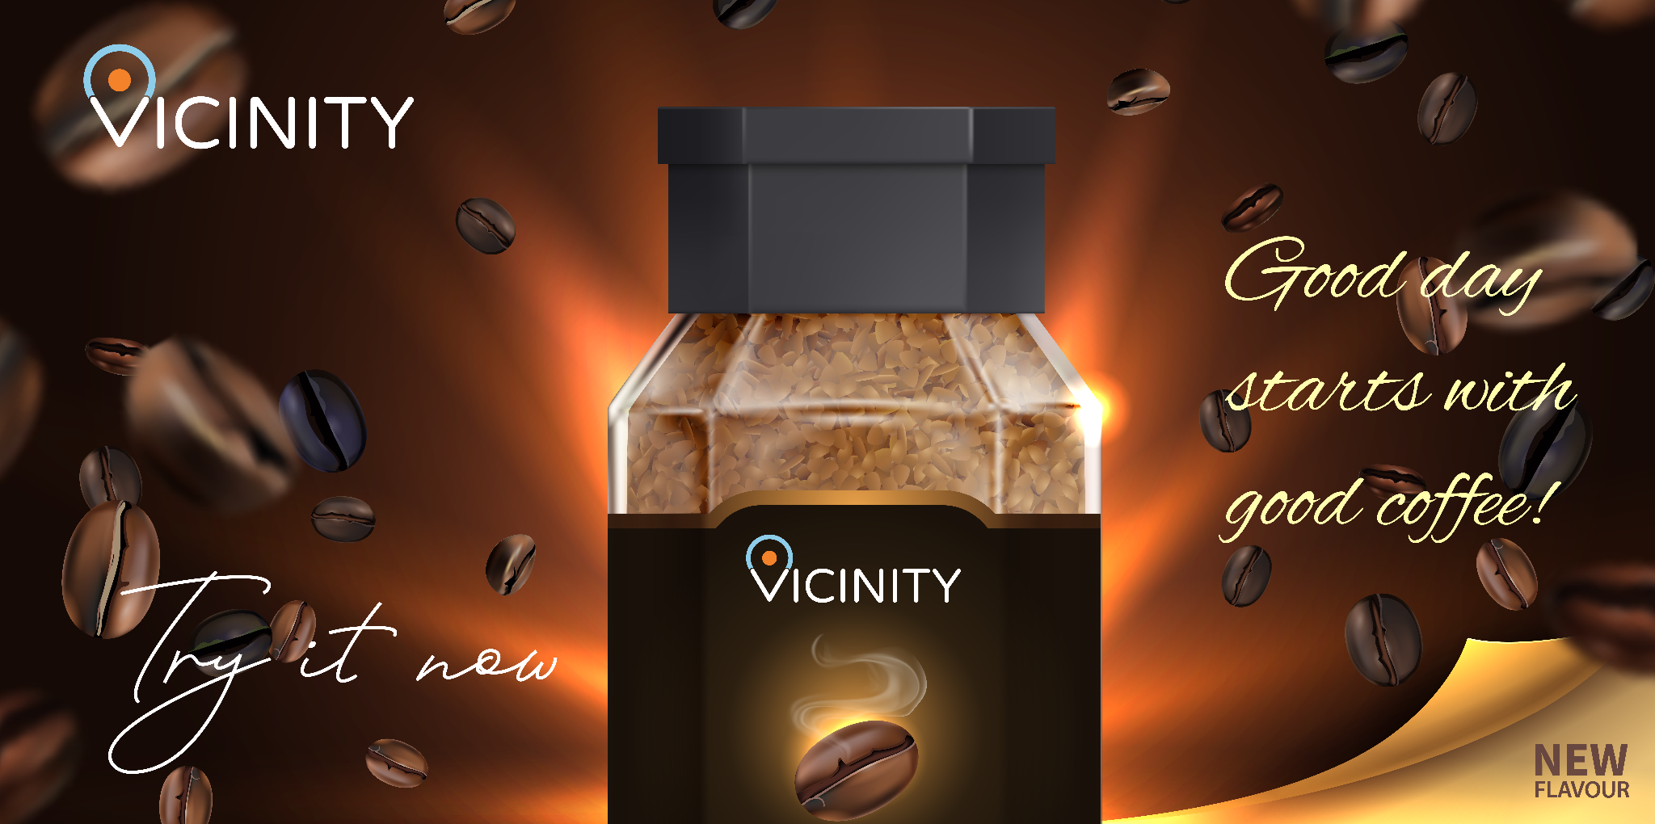

DESIGN FOR ROADSIDE IMPACT
DON’T
DO
Use cluttered visuals or text.
Use thin, hard-to-read fonts.
Keep the layout clean: one focus, one CTA.
Stick to one clear short message.
Use bold fonts & high contrast for visibility.
Keep roadside visibility in mind.

Slide 7


CONTENT IS KING, CONTEXT IS KING KONG
DON’T
DO
Use generic messaging:
✅ “Braai Favourites for the Long Weekend”
❌ “Check out our meat specials”
Localise with weather, time, or cultural moments.
Speak your audience’s language.

Slide 8

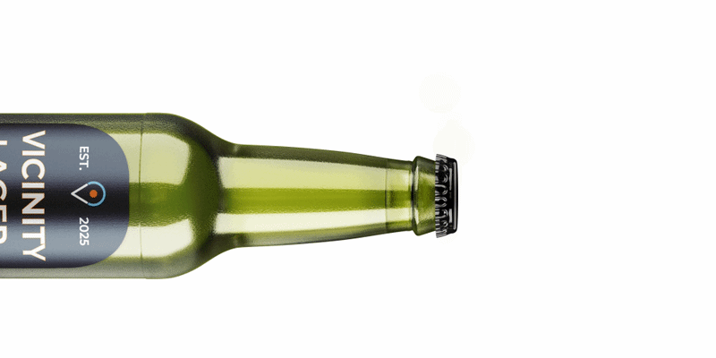
MOTION WITH PURPOSE
DON’T
DO
Use rapid pulsing or flickering visual effects.
Overdo effects in fast-moving or driver-view areas.
Use long or complex video in short-view formats.
Use subtle motion to attract attention.
Animate the key message or CTA if time allows.
Use short, simple videos.
Limit effects in fast-view areas.

Slide 9


CLEAR CALLS-TO-ACTION (CTA)
DON’T
DO
Use web-style CTAs (e.g. “Click Here”).
Rely on CTA placement alone—make it visually pop and concise.
Use CTAs like “Scan to Save” or “See In-Store”.
Add QR codes, short URLs, or directions.

Slide 10

REFRESH REGULARLY & ROTATE OFTEN
DON’T
Repeat the same message for too long.
Skip key calendar moments.
DO
Refresh creative every 4–8 weeks.
Align with seasons, promos, or local events

Slide 11


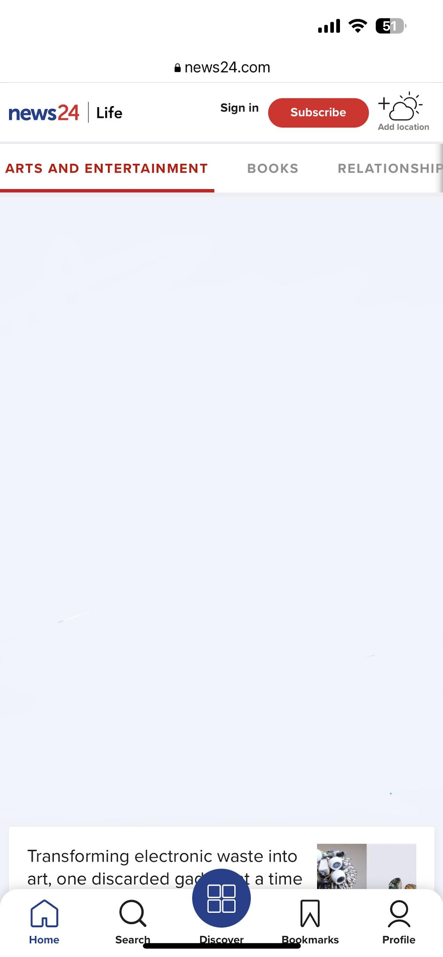
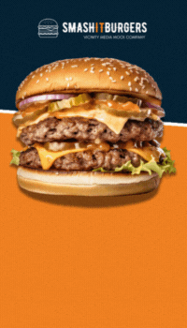
KEEP OMNICHANNEL INTEGRATION TOP OF MIND
DON’T
Silo DOOH—keep messaging consistent across platforms.
DO
Align creative on DOOH, mobile, and social.
Use DOOH to boost other promotions.

Slide 12

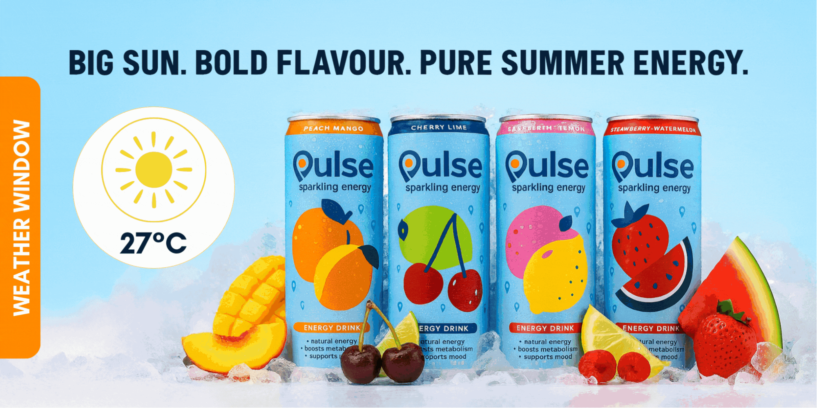
DYNAMIC DOOH EXECUTIONS
WEATHER WINDOW: Weather sponsored ads use local conditions to deliver relevant, contextual messages.
Allow sufficient space for the weather forecast display.
WEATHERTRAC: Weather-triggered ads deliver contextual messages that boost engagement.
Ensure creative fits each weather condition.
GAME-ON TECH: Live-scores and sports updates on DOOH and Mobile keeps audiences engaged.
Allow space for live scores and updates.

Slide 13

GET CLOSER

